Slide 1

A Prototype of a Machine Learning Workflow to Classify Land Use from the Housing Market Dynamics
MASc final presentation
Presented by: Stepan Oskin
Supervisor: Erik J Miller
Date: 20-Sep-2019
Notes:
Growth centers
West Don Lands
Liberty village
Riverdale
Outline
Deadline to submit thesis
Month-by-month tuition

Slide 2
Section 1:
Background

Slide 3
1.1. Personal background
Stepan Oskin, Master of Applied Science candidate at the
Department of Civil Engineering
Undergraduate degree in Mechanical Engineering
from St. Petersburg State Polytechnic University (Russia)
Started my studies at UofT in the MEngCEM program,
focused on Energy, switched to MASc focused on Data Science
After 2 terms of MEngCEM, switched to MASc inspired by
complexity studies (CEM1004)
Started my thesis under the supervision of Eric Miller,
interested in the interaction of urban systems

Slide 4
1.1. Personal background (cont.)
Under the supervision of Eric Miller, became a part of the team at the UTTRI
Spent the past year “untangling” a large historical dataset of real estate transactions (Teranet)
Designed and implemented a machine learning workflow to dynamically classify land use at a parcel level based on the housing market dynamics and Census data – primary focus of this master’s thesis

Slide 5
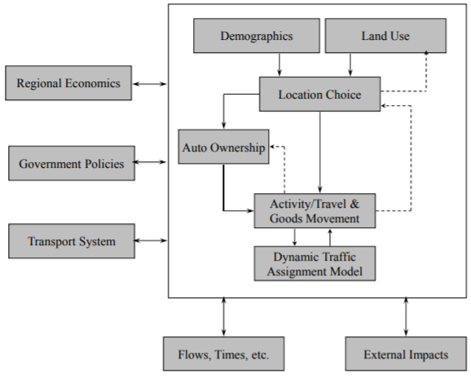
1.2. Land use and transportation research
An Idealized Integrated Urban Model System:
Source: Eric J Miller, David S Kriger, and John Douglas Hunt. Integrated Urban Models for Simulation of Transit and Land Use Policies Guidelines for Implementation and Use. 1998.

Slide 6
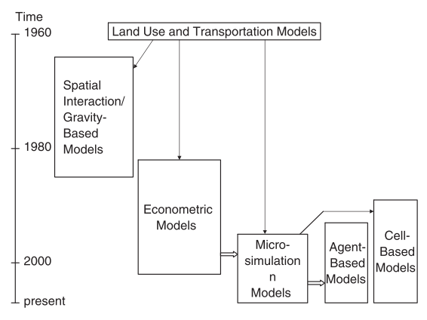
1.3. Evolution of LUT models
Source: Michael Iacono, David Levinson, and Ahmed El-Geneidy. Models of transportation and land use change: A guide to the territory. Journal of Planning Literature, 2008.

Slide 7
1.4. Motivation
Microsimulation models are “data-hungry”
Disaggregation of models is mirrored by disaggregation of data sources (Census/TTS vs Teranet)
Fine-scale housing market dynamics, heterogeneity of the GTHA housing market
“Lack and abundance” paradox: Teranet’s dataset provides a wealth of data with a lack of features

Slide 8
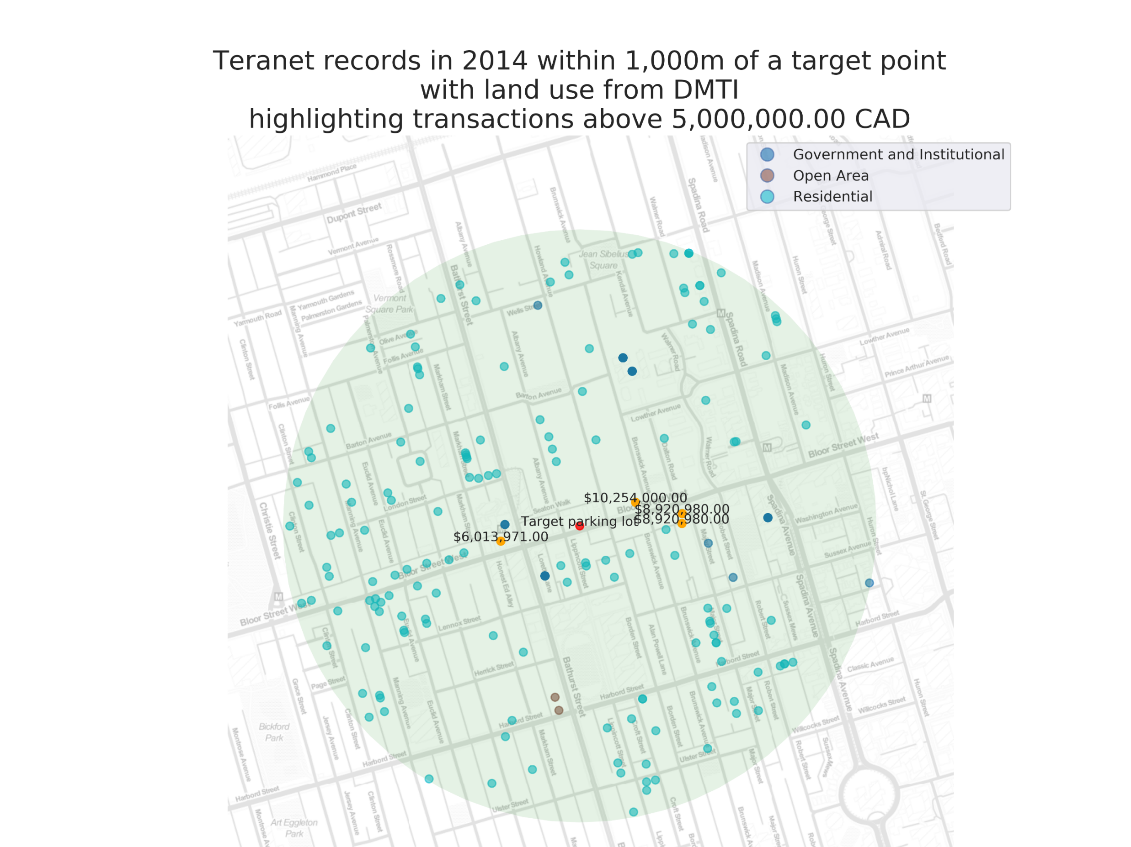
1.5 Teranet’s dataset of land registration records

Slide 9
1.6. Teranet: challenges and opportunities
Challenges:
Size of Teranet’s dataset, computational requirements
Lack of features
No ability of differentiating transactions by property type
Opportunities:
Date and location information allows joining different data sources and engineering new features
Department of Geography has manually collected detailed land use information in 2012 and 2013
Machine learning to classify land use from housing market

Slide 10
1.7. Objectives of this work
Land use from different sources (DMTI, Dept. of Geography) can be used to separate Teranet transactions by property types
If consistent and meaningful labels can be produced from land use, machine learning can be used to predict land use changes based on the housing market behaviour:
dynamically (recognizing changes real-time)
at a parcel level
with a high degree of accuracy

Slide 11
Section 3:
Data sources

Slide 12
3.1 Relationship between datasets
one
many
fk:
many
fk: pca_id
pk: year
census_year
pk: transaction_id
postal-code-level data
Census
variables
pk: DAUID
fk: dauid
DA-level data
many
fk: fsa
FSA-level data
one
many
Teranet
many
fk: csduid
pk: year
fk: tts_year
municipality-level data
pk: TAZ_O
fk: taz_o
TTS
variables
TAZ-level data
one
Dep. Of Geog.
Land Use
fk: pin_lu
pk: PIN
fk: year
many
many
parcel-level data
time-indexed data
Fuel prices
Inflation
coefs.
DMTI
Land Use
DMTI
Land Use
EPOI
DMTI
Land Use
EPOI
EPOI
one
pk: year

Slide 13
2.1. Data sources used
Teranet
Select Census variables
Select TTS variables
DMTI land use
Detailed land use (Department of Geography)

Slide 14
2.2. Spatial units used by different sources
Teranet: point (parcel centroid)
Select Census variables: DA polygon
Select TTS variables: TAZ polygon (2001 zone system)
DMTI land use: parcel
Detailed land use (Department of Geography): parcel

Slide 15
2.3. Matching spatial units
Challenges:
Spatially joining polygon-based data is challenging
Combining sources needs spatial joins to connect primary keys or area weighted spatial interpolation of data to a common unit of analysis
Boundaries may change over time
Proposed solution:
Relate all polygon-based data to time-indexed points
Polygon-based Census and TTS data can be joined to Teranet points with respect to temporal relationships (discussed next)

Slide 16
2.4. Temporal spans of different sources
Teranet: timestamp (date)
Select Census variables: once in 5 years
Select TTS variables: once in 5 years
DMTI land use: 2001-2014, by year
Detailed land use (Department of Geography): 2011-2012

Slide 17
2.4. Temporal spans of different sources
Teranet: (...)1985-2017
Select Census variables: ...2001, 2006, 2011, 2016
Select TTS variables: 1986, ... , 2001, 2006, 2011, 2016
DMTI land use: 2001-2014, by year
Detailed land use (Department of Geography): 2011-2012

Slide 18
2.4. Temporal spans of different sources
DATA SOURCES | 1999 | 2000 | 2001 | 2002 | 2003 | 2004 | 2005 | 2006 | 2007 | 2008 | 2009 | 2010 | 2011 | 2012 | 2013 | 2014 | 2015 | 2016 | 2017
Census
TTS
DMTI land use
DMTI postal codes
DMTI EPOI
EMME network calculations
Teranet
Dept of Geography land use
Fuel price in Toronto

Slide 19
2.5. Matching temporal spans
Challenges:
Discrete vs “continuous” measurements
Census and TTS variables are sampled once every 5 years, while Teranet data is recorded daily
Urban form is continuously evolving
Land use information can become inaccurate with time
Aggregation or interpolation required
Aggregation or interpolation is required to match the different data sources used for longitudinal studies

Slide 20
2.5. Matching temporal spans
Proposed solution (options):
Direct match
Use only subsets of Teranet records for appropriate Census/TTS year
Benefits: precision of measurement
Disadvantages: limited use of Teranet
Interpolate discrete measurements
Census / TTS variables can be turned into continuous via interpolation
Benefits: closest match by time
Disadvantages: more assumptions
Assign Census/TTS temporal spans to Teranet records
Each Census / TTS survey can be assigned a temporal span of 5 years
Benefits: avoid interpolation – less assumptions and preprocessing
Disadvantages: step-change in Census/TTS variables, varying accuracy

Slide 21
2.5. Matching temporal spans
DATA SOURCES | 1999 | 2000 | 2001 | 2002 | 2003 | 2004 | 2005 | 2006 | 2007 | 2008 | 2009 | 2010 | 2011 | 2012 | 2013 | 2014 | 2015 | 2016 | 2017
Census
TTS
DMTI land use
DMTI postal codes
DMTI EPOI
EMME network calculations
Teranet
Dept of Geography land use
Fuel price in Toronto
Each Census / TTS year gets assigned a 5-year span
to match to Teranet records.

Slide 22
Section 3:
Data preparation

Slide 23
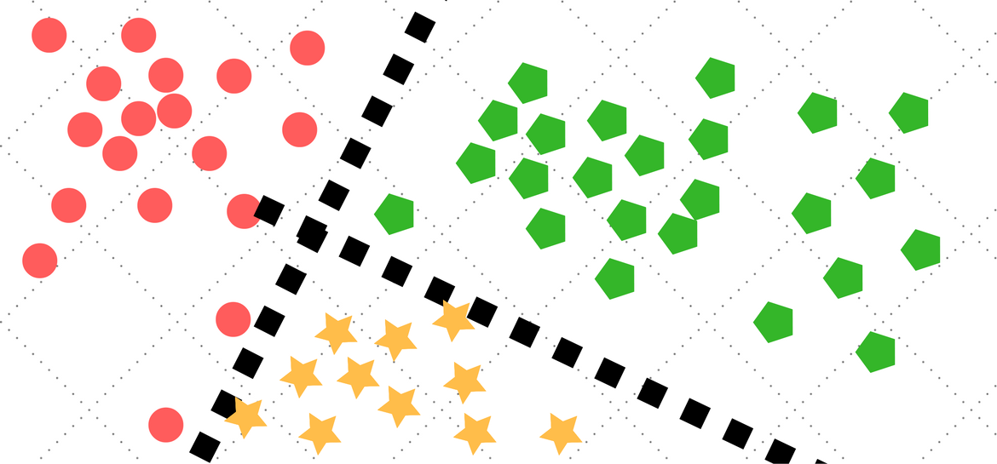
3.1 Data preparation: all data sources
Classification
algorithm
price > 10’000 CAD,
new attributes
Spatial joins
GTHA land use
Correct for
consistency
Convert Hamilton to GTA codes
Spatial joins
GTA + Hamilton
Land use
Tidy
Tidy
Land use
Concat
Teranet dataset
Select Census variables
Select TTS variables
Land use
Land use
GTA land use
Hamilton
land use
Teranet
Census
TTS
DMTI
Geo department
points
DA-level
TAZ-level
parcel-level
parcel-level

Slide 24
3.2. Teranet data preparation
4.
Encode target classes,
join with Census / TTS variables
Classification
algorithm
1.
2.
3.
Add foreign
keys via spatial joins
Correct
for
consist-ency
Add new attributes
0.
Raw
Teranet
data
final
Raw Teranet data:
9,039,241 rows
15 columns
Augmented and filtered
Teranet data:
5,188,513 rows
79 columns
Predicted
land use

Slide 25
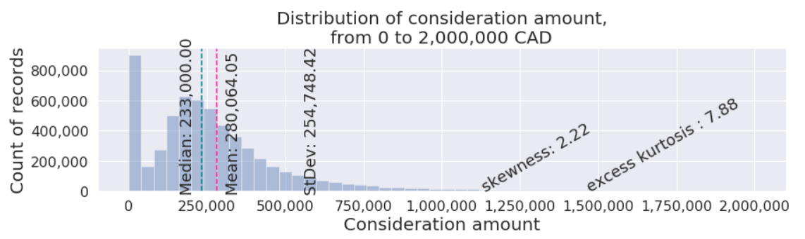
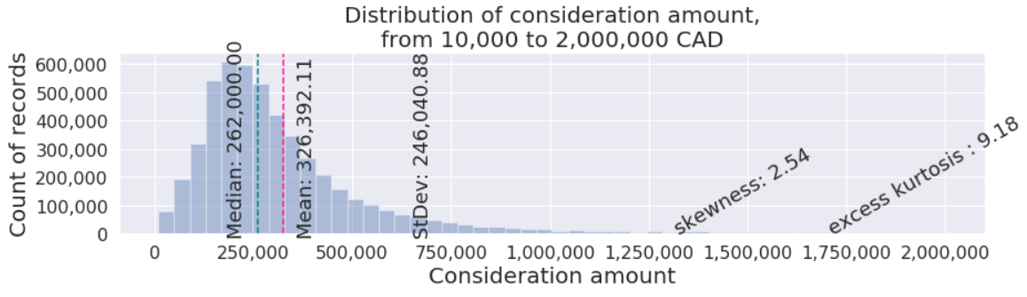
3.3. Outliers
Bottom outliers: records with price < 10’000 CAD removed.

Slide 26
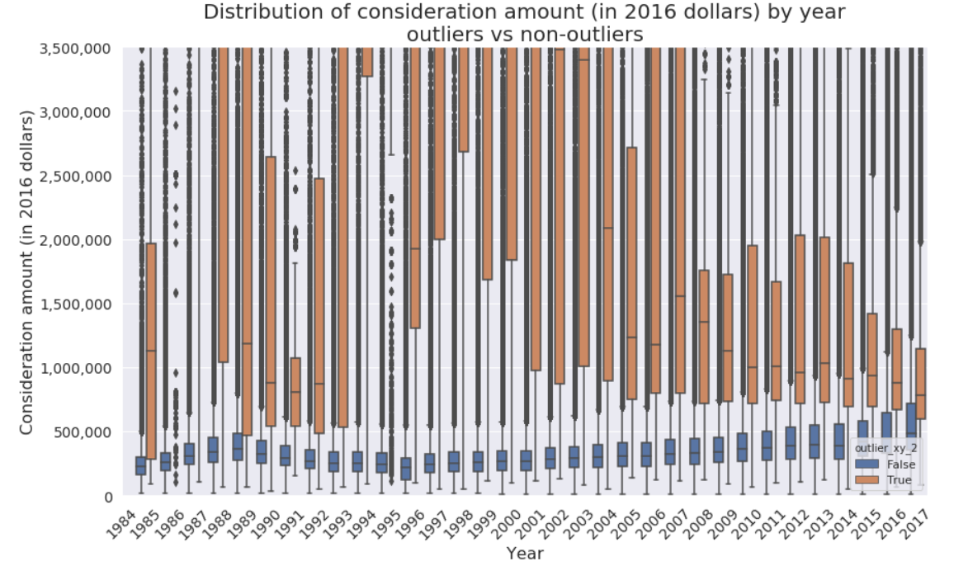
3.3. Outliers
`outlier_xy_2`:
Top outliers “peeled” in layers: 7 different criteria used

Slide 27
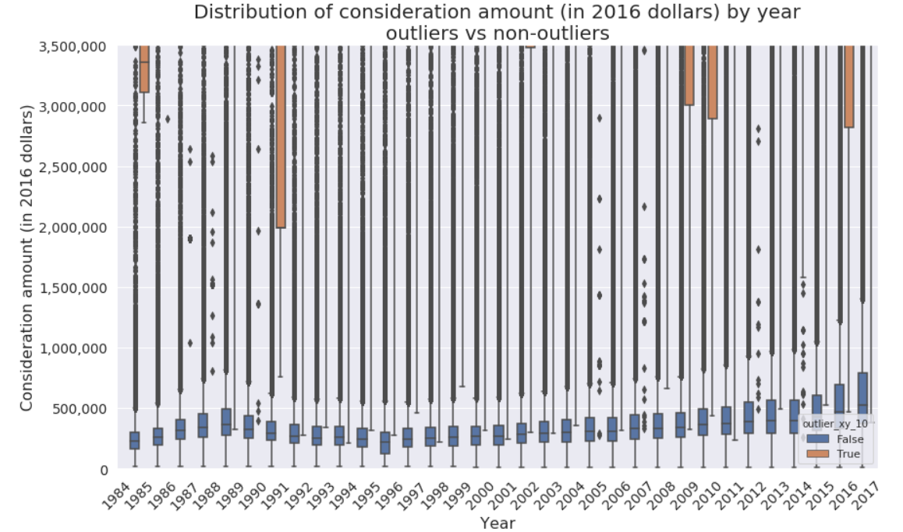
3.3. Outliers
`outlier_xy_10`:
Top outliers “peeled” in layers: 7 different criteria used

Slide 28
Section 4:
Land use classes

Slide 29
4. Land uses classes (target variable)
The top 10 land use categories (by frequency) from detailed land use are regrouped into 4 target classes:
“detached”: Single Detached House
“duplex_townhouse”: Duplex/Semi-Detached or Townhouse
“condo”: Apartments/Condos/Residence or Strata Townhouses
“other”: mixed, commercial, industrial, and everything else

Slide 30
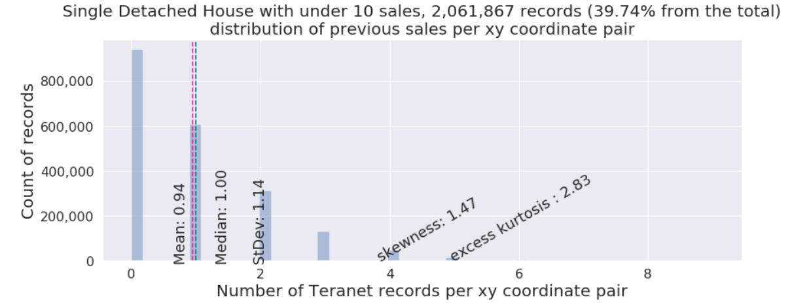
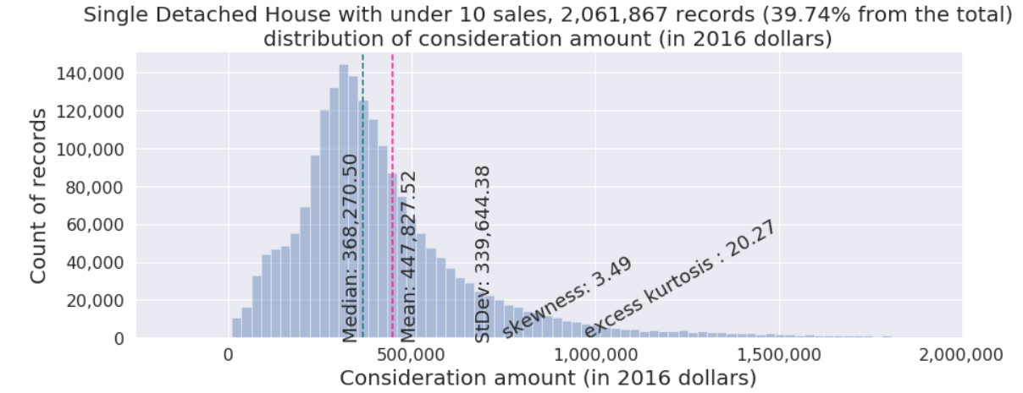
4. Land use class 1: detached

Slide 31
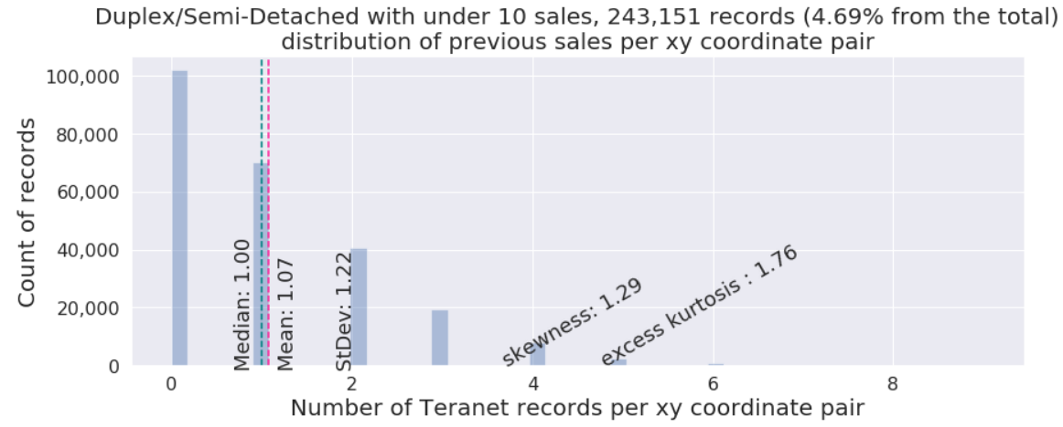
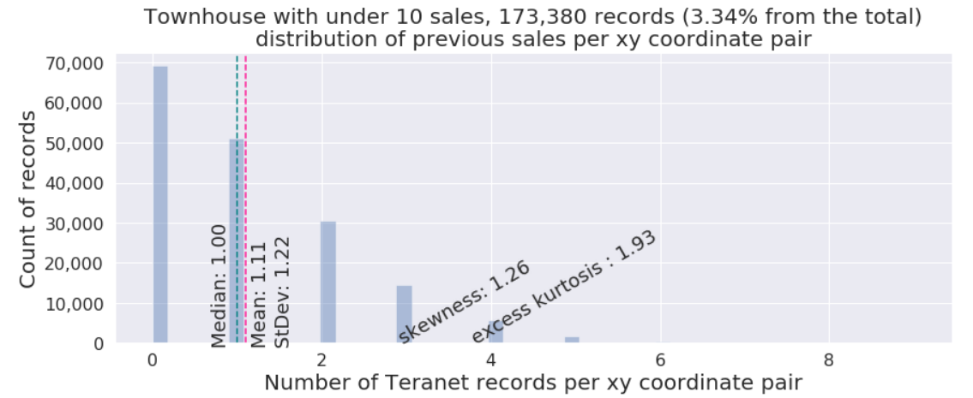
4. Land use class 2: duplex/townhouse

Slide 32
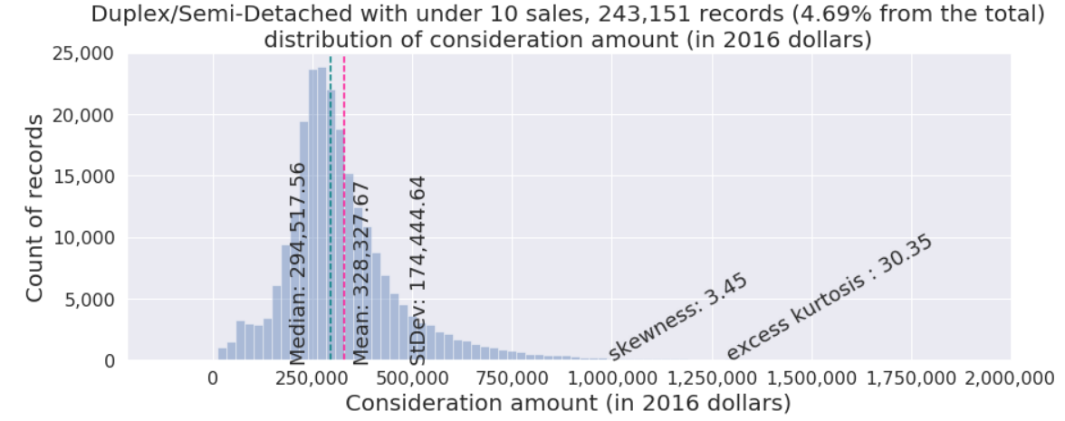
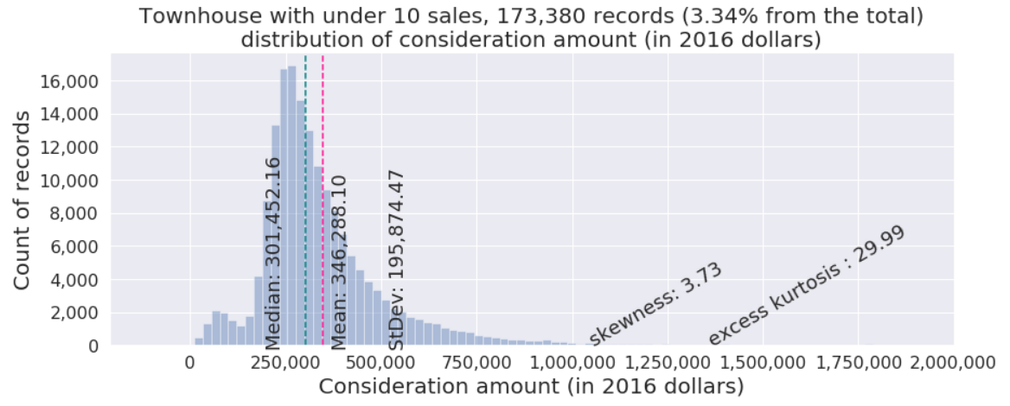
4. Land use class 2: duplex/townhouse

Slide 33
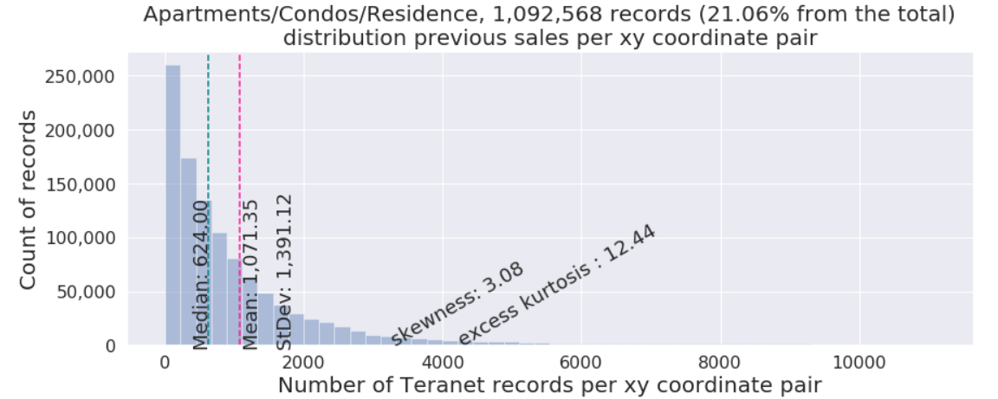
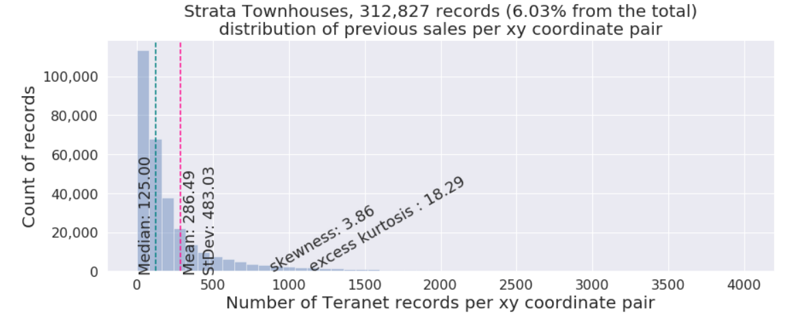
4. Land use class 3: condo / strata

Slide 34
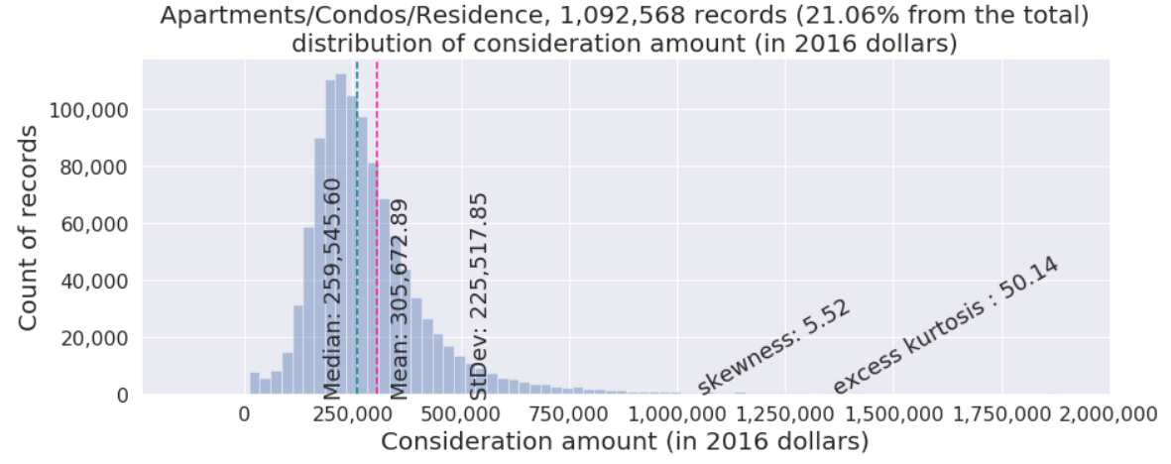
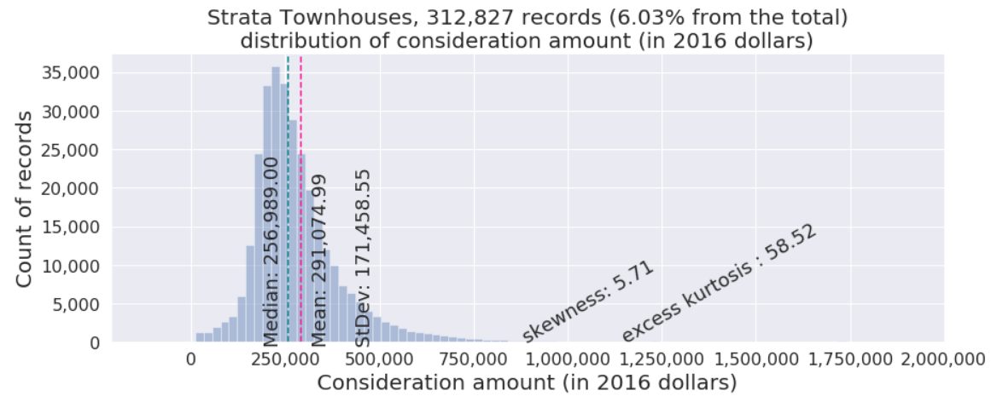
4. Land use class 3: condo / strata

Slide 35
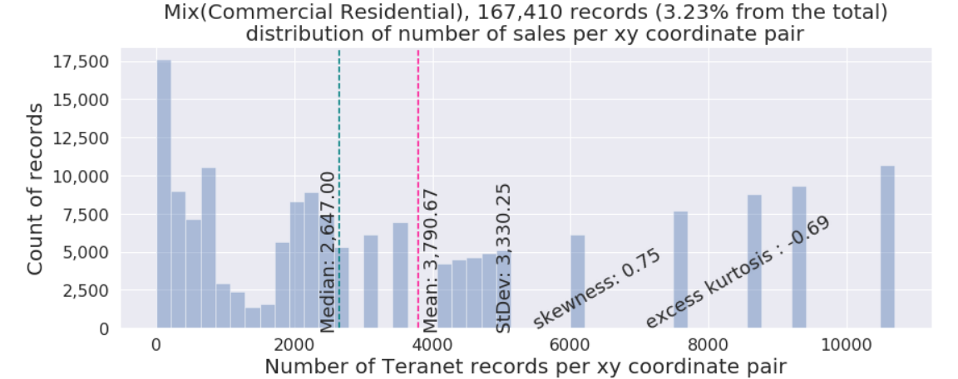
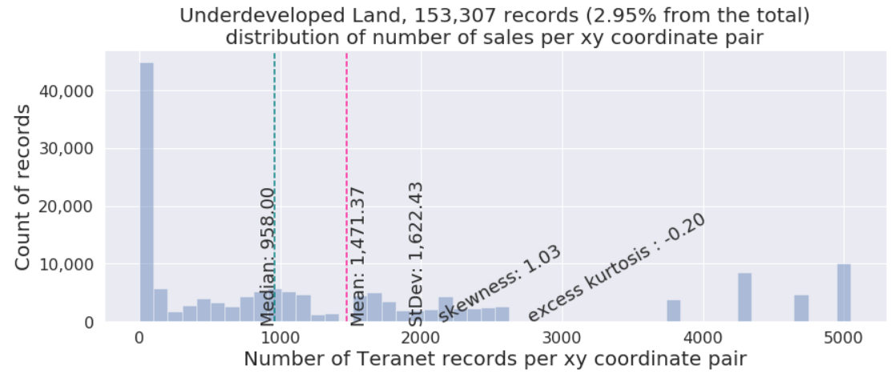
4. Land use class 4: other (examples)

Slide 36
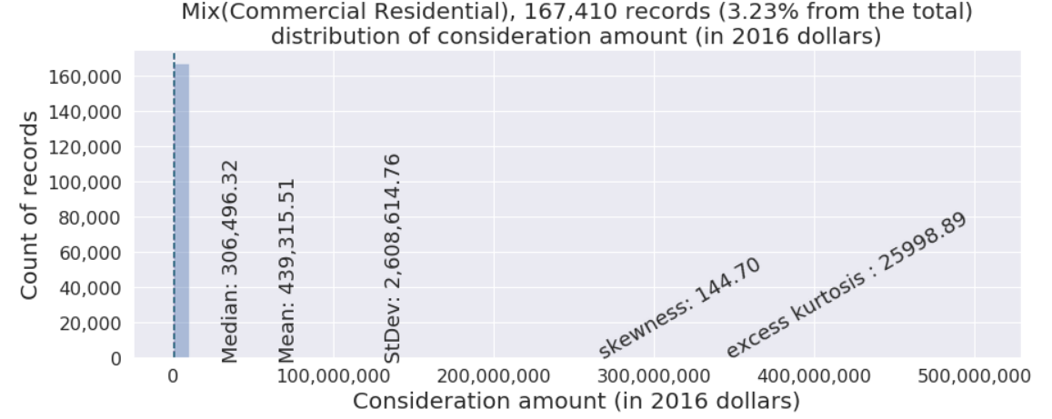
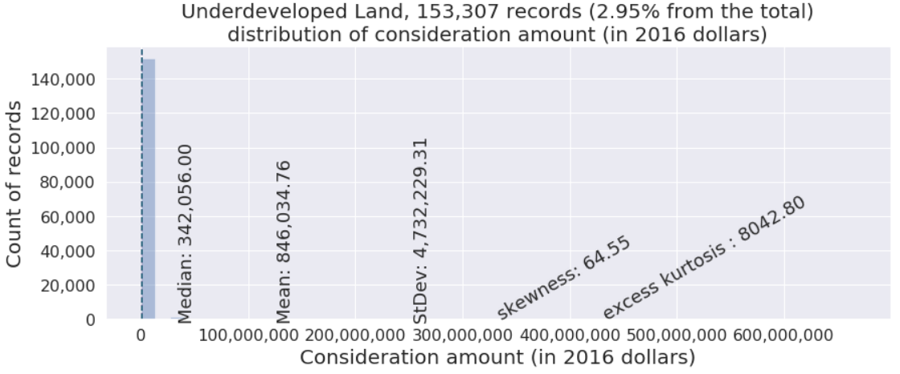
4. Land use class 4: other (examples)

Slide 37
Section 5:
Feature selection

Slide 38
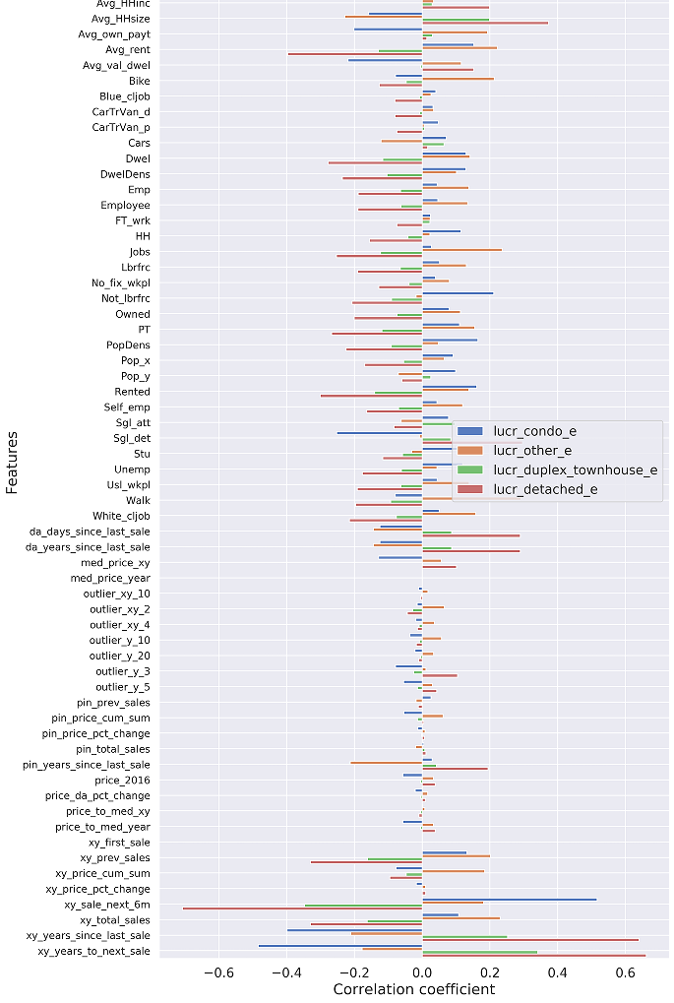
5.1. Augmented data
Data preparation step
augmented Teranet dataset
from 4 features to 64:
'lro_num’,
'pin', 'consideration_amt', 'registration_date', 'POSTAL_CODE', 'PROVINCE’,
'UNITNO', 'STREET_NAME', 'STREET_DESIGNATION', 'STREET_DIRECTION', 'MUNICIPALITY', 'STREET_SUFFIX', 'STREET_NUMBER’,
'X', 'Y'

Slide 39
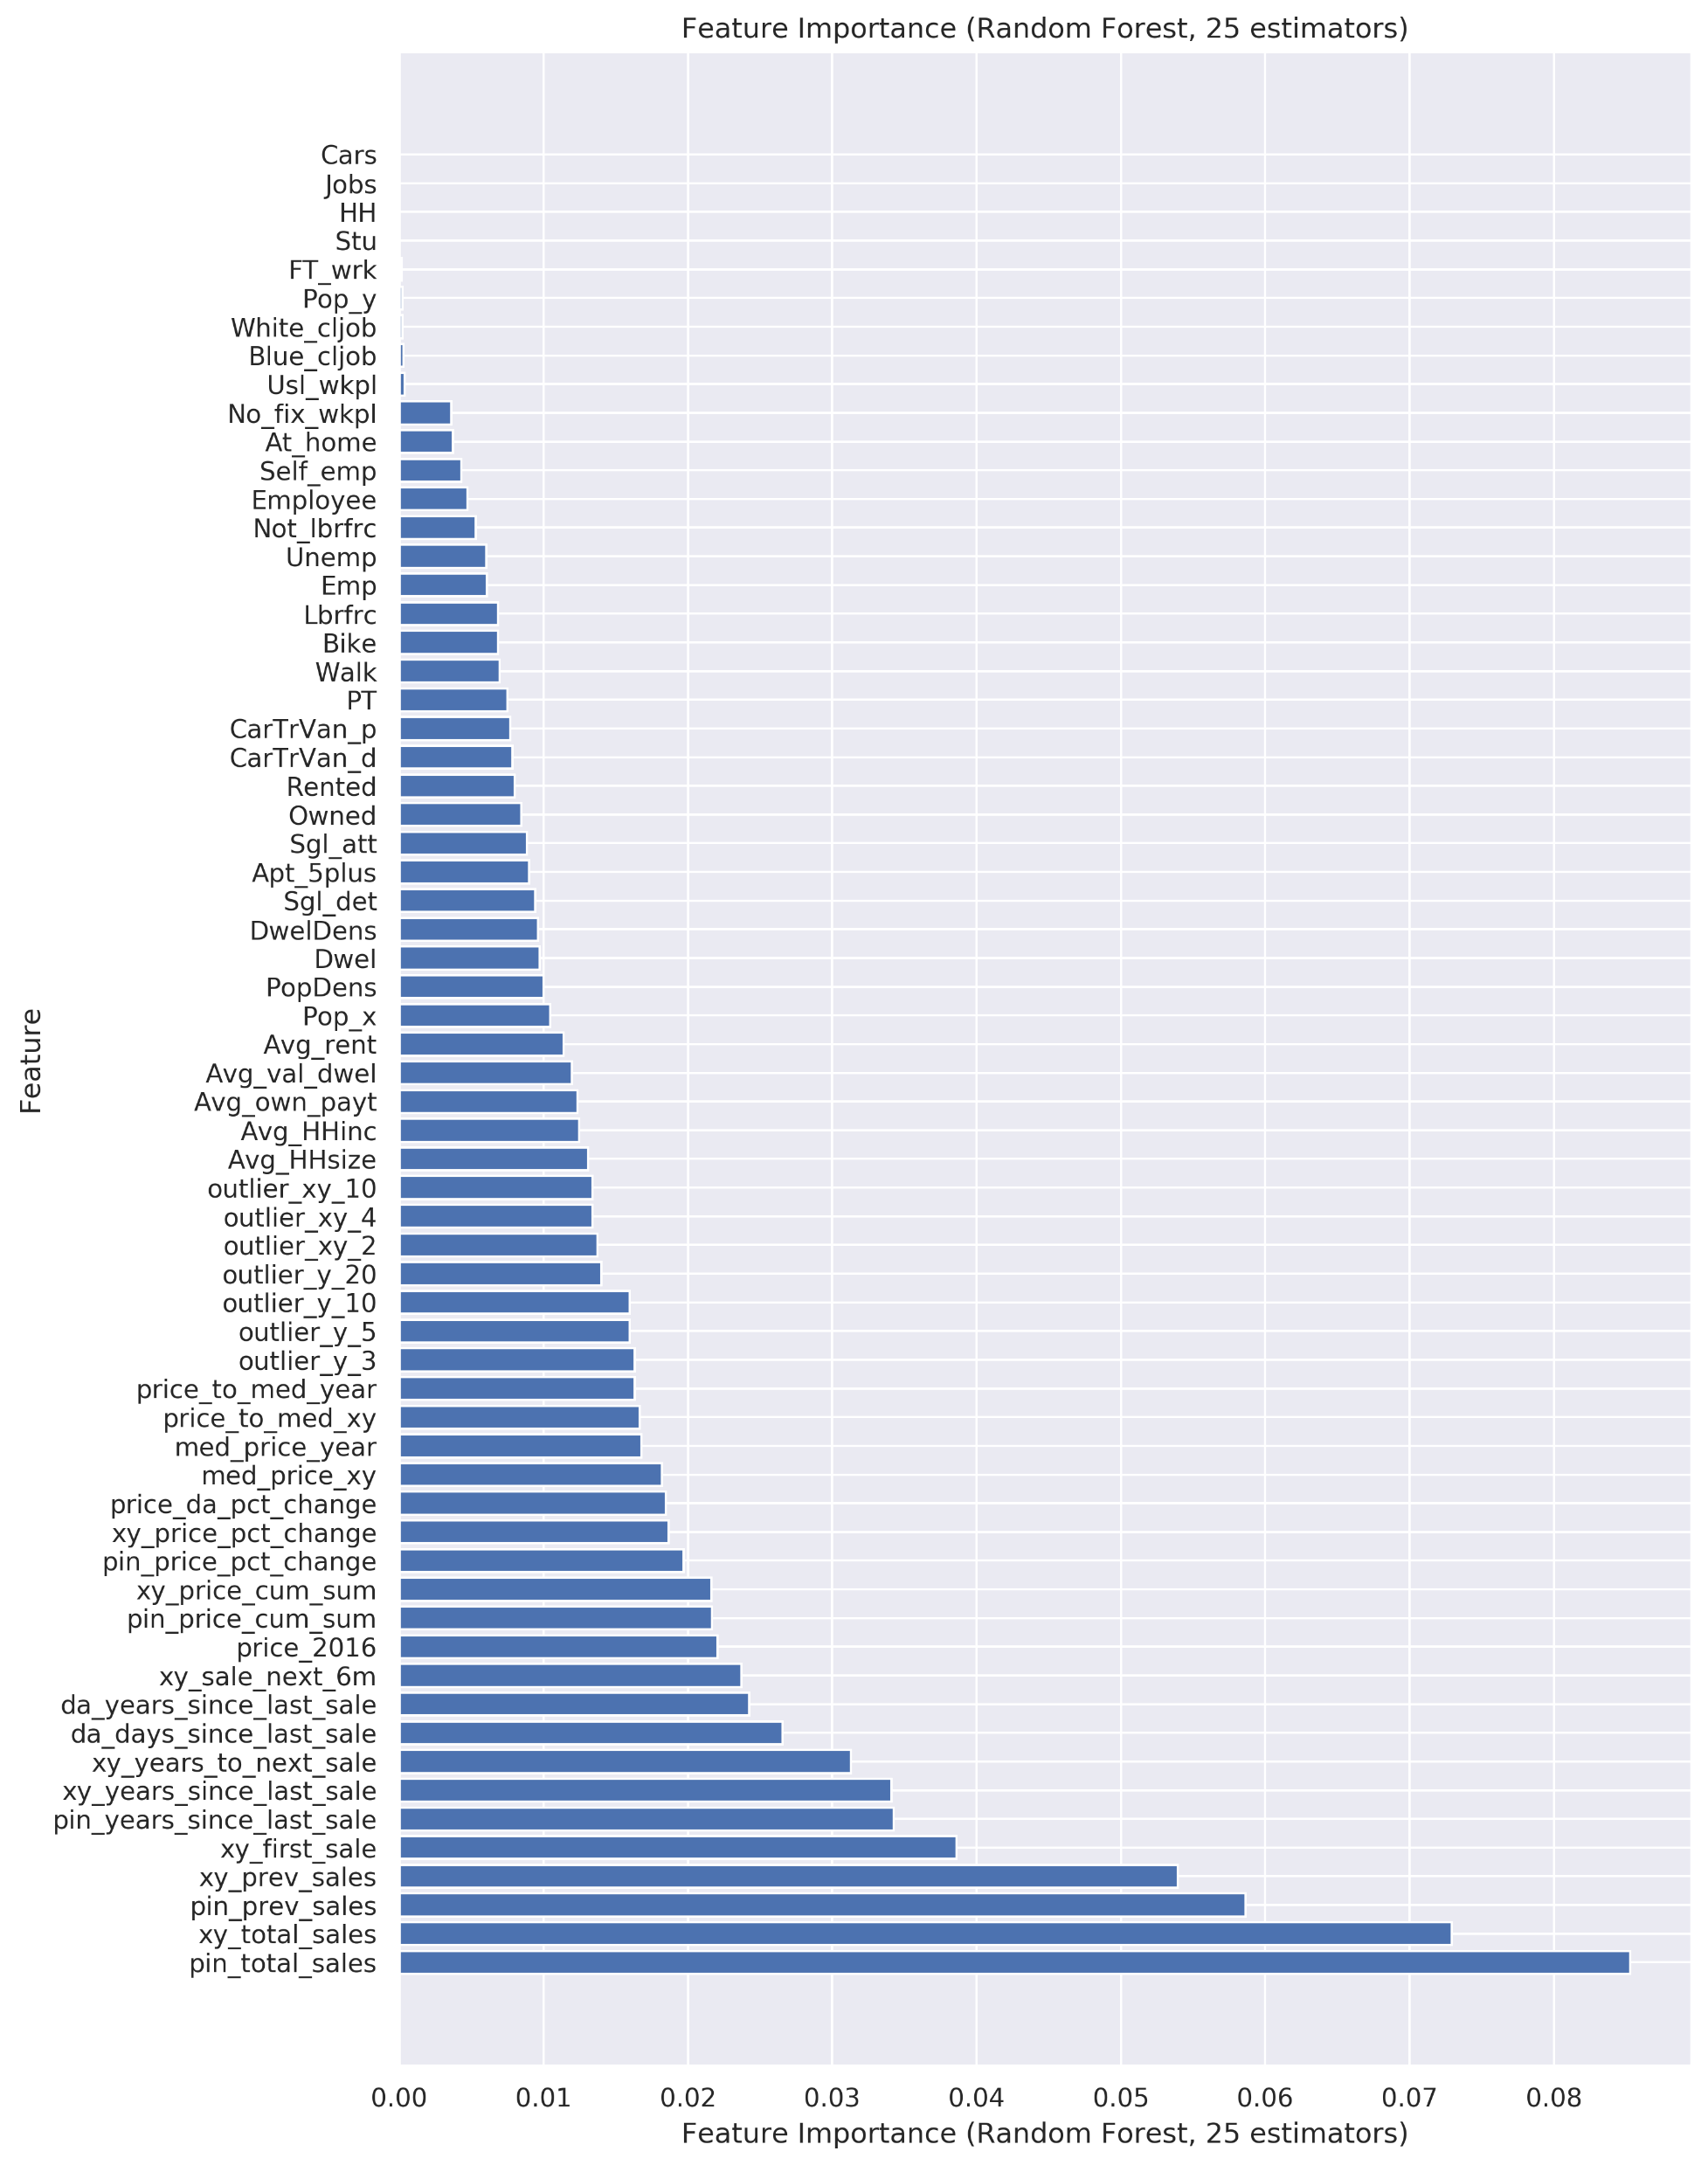
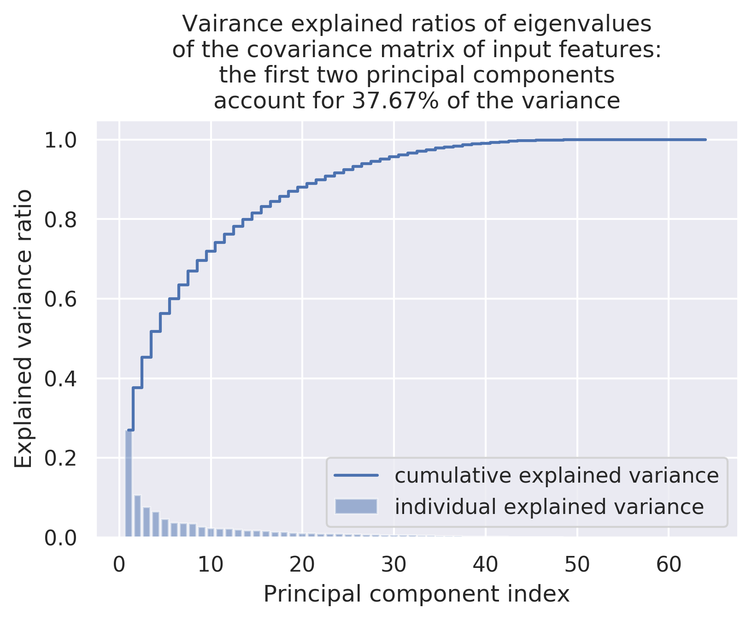
5.2. Feature selection: PCA and Random Forest
PCA:

Slide 40
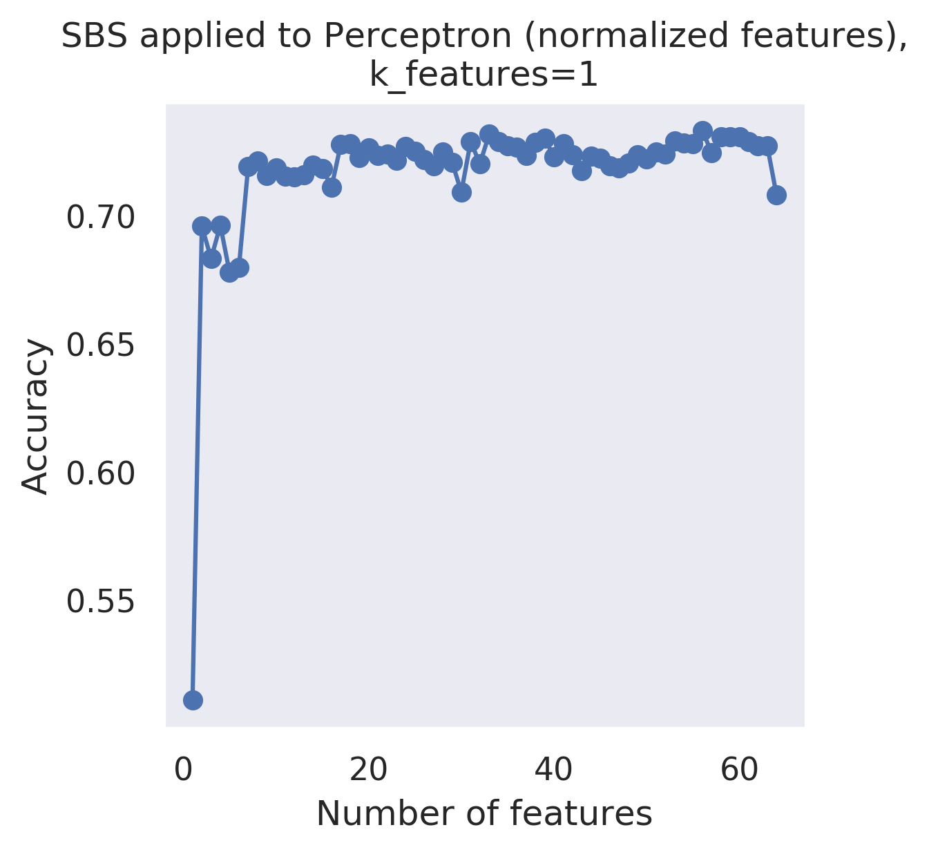
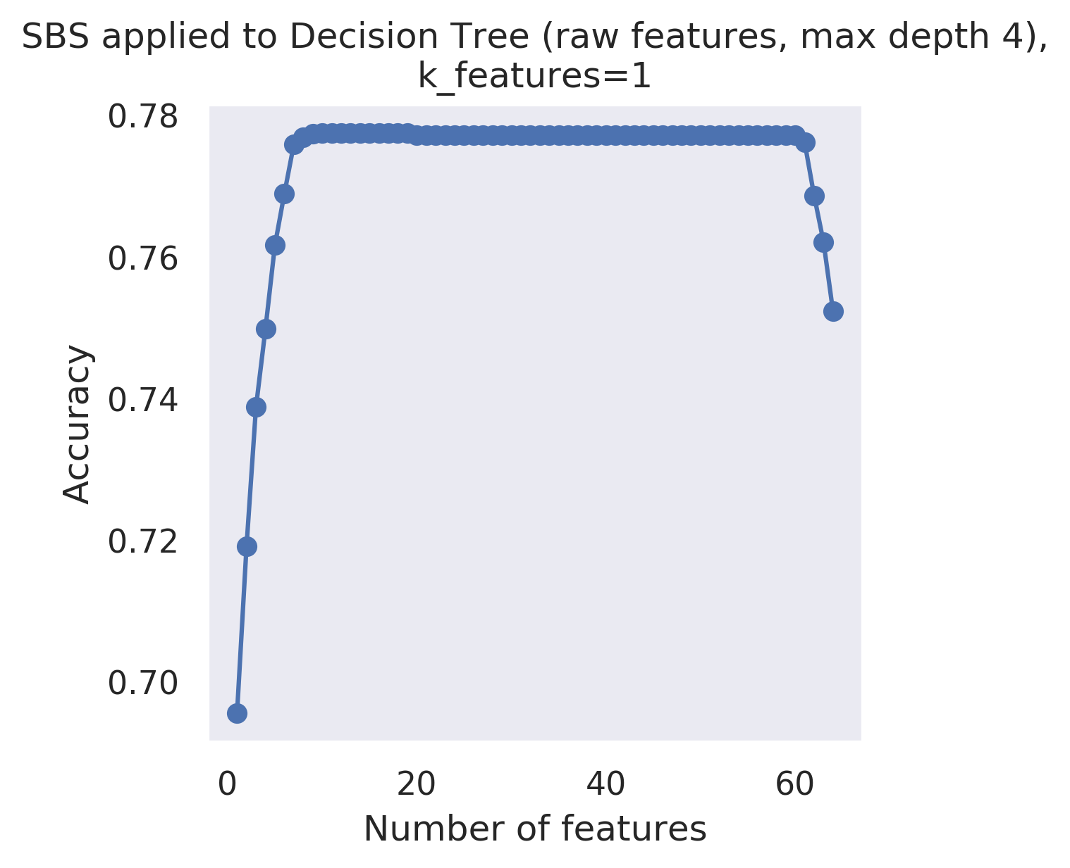
5.3. Feature selection: SBS algorithm
Sequential Backward Selection (SBS) algorithm determined 9 features most relevant to models

Slide 41
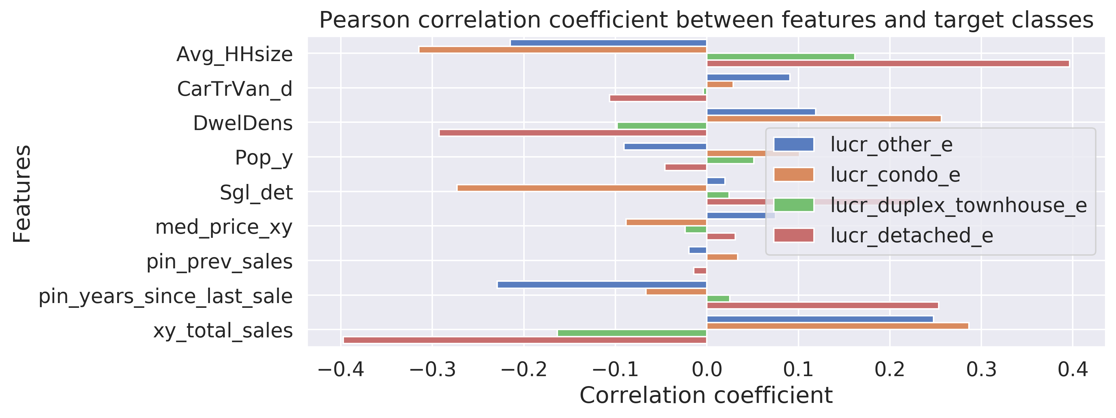
5.3. Feature selection: SBS algorithm
Sequential Backward Selection (SBS) algorithm determined 9 features most relevant to models

Slide 42
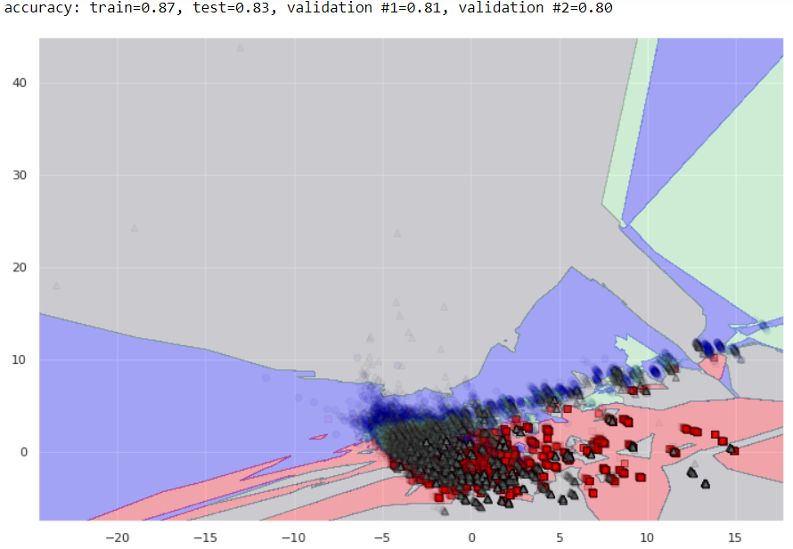
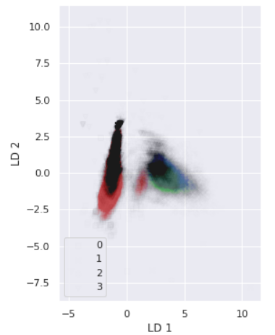
5.4. Feature selection: dimensionality reduction
LDA
PCA (KNN)
PCA and LDA were attempted but did not offer sufficient improvement

Slide 43
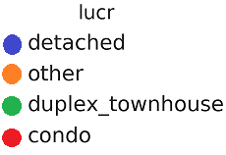
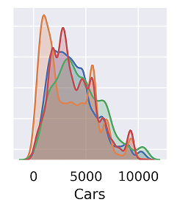
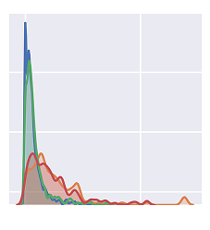
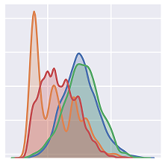
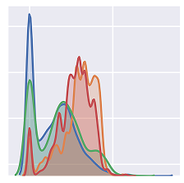
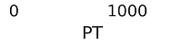

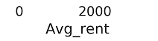
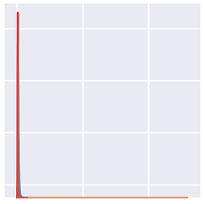
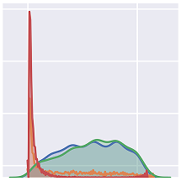
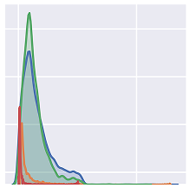
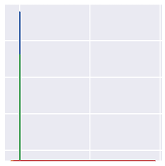
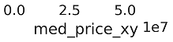
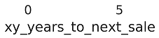
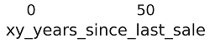
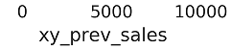
5.5. Selected features
Legend:
PCA (KNN)

Slide 44
Section 6:
Classification

Slide 45
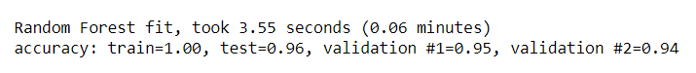
5.5. Train-test-validation split
Subset of records from 2012 used to train and test model (70-30 random split)
Records from 2011 and 2012 are used to validate predictions

Slide 46
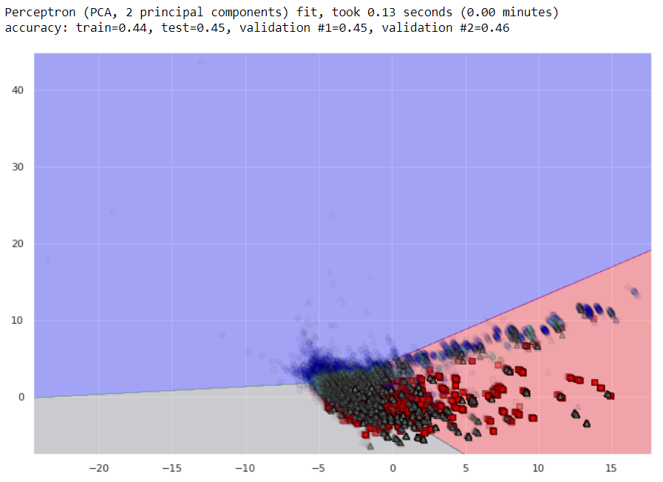
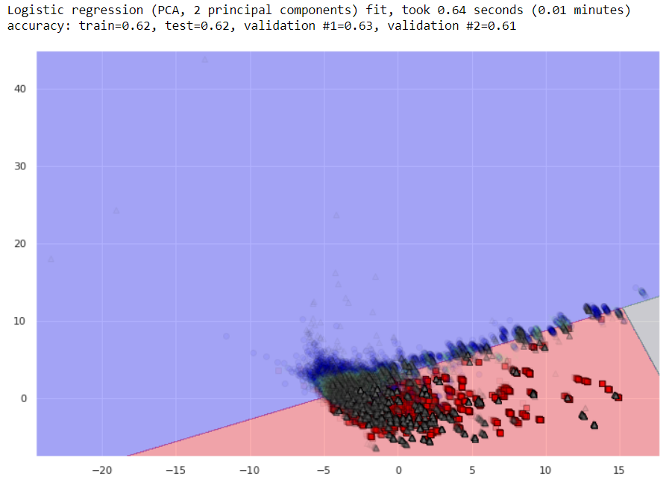
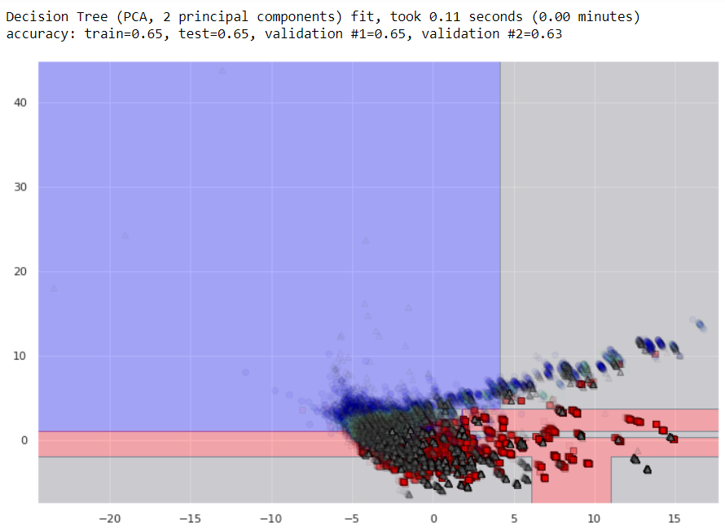
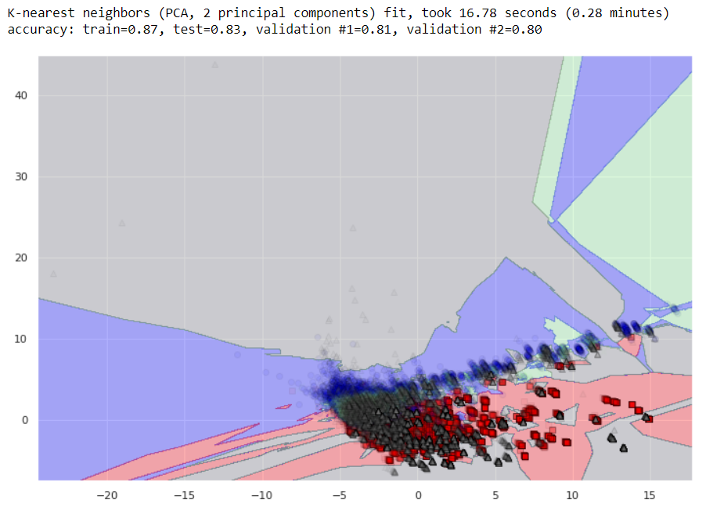
6.1. Classification algorithms attempted
Perceptron
Logistic regression
Decision Tree
K-Nearest Neighbors

Slide 47

6.2. Best preforming algorithm: Random Forest
Random Forest
Best performance on all 64 features:

Slide 48



6.2. Hyperparameters: Perceptron
‘top19f_18_fillna’ feature set
RAW FEATURES
NORMALIZED FEATURES
NORMALIZED FEATURES

Slide 49



6.2. Hyperparameters: Logistic Regression
‘top19f_18_fillna’ feature set
RAW FEATURES
NORMALIZED FEATURES
NORMALIZED FEATURES

Slide 50
6.2. Best preforming algorithm: Random Forest
Best performance on all 64 features: 94-95% on validation
Used to produce new attribute `lucr_predict_af`
Best performance on 9 features from SBS: 91-93% on validation
Used to produce new attribute `lucr_predict_9f`

Slide 51
6.2. Best preforming algorithm: Random Forest
Random Forest classification algorithm offers
the best performance:
Best accuracy (94-95% on validation sets with all features)
Computational efficiency
Easily parallelized “out-of-the-box” in scikit-learn
Scalable

Slide 52
Section 7:
Results

Slide 53

7.1. Detailed land use joined to Teranet records

Slide 54

7.1. DMTI vs Department of Geography
Land use from the Department of Geography is
more detailed and more accurate (but limited in time)

Slide 55

7.2. Predicted land use added as a new feature

Slide 56

7.2. Department of Geography vs predicted
Points are colored
by predicted land use

Slide 57
7.3 Results are stored as a database
Add to the database
price > 10’000 CAD,
new attributes
Classification
algorithm
PostgreSQL
Spatial joins
GTHA land use
Correct for
consistency
Convert Hamilton to GTA codes
Spatial joins
GTA + Hamilton
Land use
Tidy
Tidy
Land use
Concat
Teranet dataset
Select Census variables
Select TTS variables
Land use
Land use
GTA land use
Hamilton
land use
Teranet
Census
TTS
DMTI
Geo department
points
DA-level
TAZ-level
parcel-level
parcel-level

Slide 58

7.3. Entity relationship (ER) diagram
PIN-level data
(e.g., land use,
EPOI, etc.)
DA-level data
(e.g., select
Census variables)
Time-indexed
data
(e.g., fuel prices)
Postal-code
level data
TAZ-level data
FSA-level
data
Teranet dataset is related to multiple groups of datasets
based on different spatial and temporal relationships.

Slide 59


7.3 SQL example: join different datasets
This query joins attributes from various data sources at Teranet transaction level:
Select variables and specify column names
Join data sources
PIN-level data
(e.g., land use,
EPOI, etc.)
DA-level data
(e.g., select
Census variables)
Time-indexed
data
(e.g., fuel prices)
Postal-code
level data
TAZ-level data
FSA-level
data

Slide 60
Section 7:
Conclusion

Slide 61
7. Conclusion
Land use from different sources can be used to separate Teranet transactions by property types
If consistent and meaningful labels are produced from Dept. of Geography’s land use, machine learning can be used to predict land use changes based on the housing market behaviour:
dynamically (recognizing changes real-time)
at a parcel level
with a high degree of accuracy

Slide 62
Thank you!
Questions?

Slide 63
Appendix

Slide 64
Received from Teranet
2.1.1_teranet_gtha_da_spatial_join.ipynb
2.1 Teranet Spatial joins
Raw
Teranet dataset
9,039,241 rows
15 columns
points
Teranet
Teranet
data/teranet/1.1_Teranet_DA.csv
Spatial
join #1
how=‘inner’,
op=‘within’
Teranet,
filtered for GTHA,
+DA keys
6,803,691 rows
18 columns
points
data/teranet/HHSaleHistory.csv
(*) https://opendata.arcgis.com/datasets/9d262f8a576842fbb2afbc8c51a64178_1.geojson
2.1.2_teranet_taz_spatial_join.ipynb
da_census_income_obtain.ipynb
Add columns
'DAUID', 'CSDUID', 'CSDNAME'
data/teranet/1.2_Teranet_DA_TAZ.csv
DA-level
Profiles of Income
2016 Census
Esri Open
Data Portal (*)
GTHA
DA-level
Profiles of Income
2016 Census
9,182 rows
218 columns
polygons
Spatial
join #2
how=‘left’,
op=‘within’
Teranet,
filtered for GTHA,
+DA, TAZ keys
6,803,756 rows
19 columns
points
Census
data/da_census/da_census_income.csv
Add column
'TAZ_O'
taz_info_obtain.ipynb
Spatial
join #3.1
how=‘left’,
op=‘within’
GTHA
TAZ geometry and general info
1,716 rows
5 columns
polygons
data/teranet/1.3_Teranet_DA_TAZ_PG_FSA.csv
Transportation
Analysis Zones
(TAZ)
TAZ/TTS
Add column
‘FSA'
Teranet,
filtered for GTHA,
+DA, TAZ,
FSA keys
6,803,756 rows
24 columns
points
2.1.3_teranet_pg_fsa_spatial_join.ipynb
data/da_census/da_census_income.csv
Spatial
join #3.2
how=‘left’,
op=‘within’
DMTI
Download from library website (**)
https://mdl.library.utoronto.ca/collections/geospatial-data/platinum-postal-code-suite-4
Canada
FSA geometry
1,614 rows
4 columns
polygons
6,803,767 rows
27 columns
points
Forward
Sortation Areas
(FSA)
Add columns
‘PCA_ID', ‘postal_code_dmti’,
‘MAF_ID’, ‘DEL_M_ID'
Ontario
Postal Code Geography
555,668 rows
12 columns
polygons
Postal Code
Geography
Spatial
join #4
how=‘left’,
op=‘within’
Teranet dataset,
filtered for GTHA,
+DA, TAZ, FSA, PCA_ID, pin_lu keys
lu_obtain.ipynb
2.1.4_teranet_lu_spatial_join.ipynb
Geography
dept.
GTHA
parcel-level land use
1,664,862 rows
18 columns
polygons
Parcel-level
Land Use
for GTA
and Hamilton
Add columns: ‘pin_lu', ‘LANDUSE', ‘PROP_CODE'
data/teranet/1.4_Teranet_DA_TAZ_FSA_LU.csv

Slide 65
2. Teranet preparation data flow
2.1.1_teranet_gtha_da_spatial_join.ipynb
2.1.2_teranet_taz_spatial_join.ipynb
2.1.3_teranet_pg_fsa_spatial_join.ipynb
2.1.4_teranet_lu_spatial_join.ipynb
2.3_teranet_new_cols.ipynb
2.3_teranet_nonan_new_cols.ipynb
(4.) Remove duplicates
(pending)
2.2_teranet_consistency.ipynb
0.
1.
Correct
for
consistency
Add to the database
Raw
Teranet
data
2.
3.
final
Add foreign
keys via spatial joins
Add new attributes
HHSaleHistory.csv
2_Teranet_consistent.csv
PostgreSQL
1.1_Teranet_DA.csv
1.2_Teranet_DA_TAZ.csv
1.3_Teranet_DA_TAZ_FSA.csv
1.4_Teranet_DA_TAZ_FSA_LU.csv
3_Teranet_new_cols.csv
3_Teranet_nonan_new_cols.csv

